Slide 1

Project Idea

Slide 2



Project Idea
?
?

Slide 3
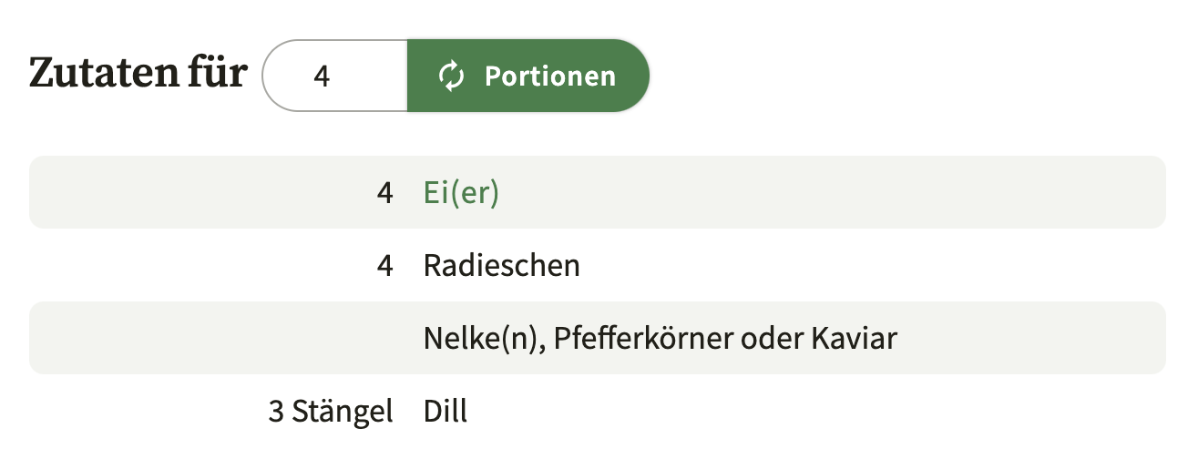
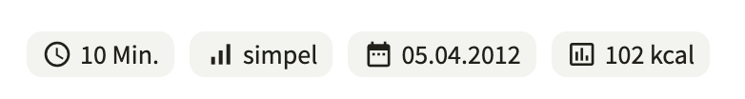
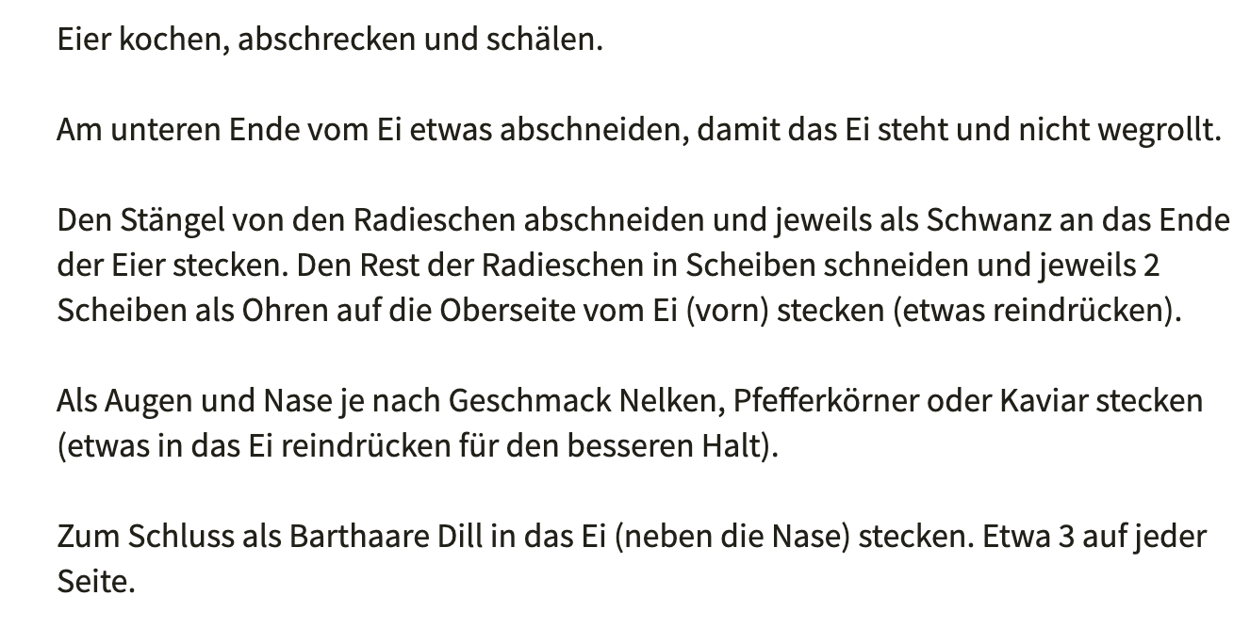
Project Idea

Slide 4

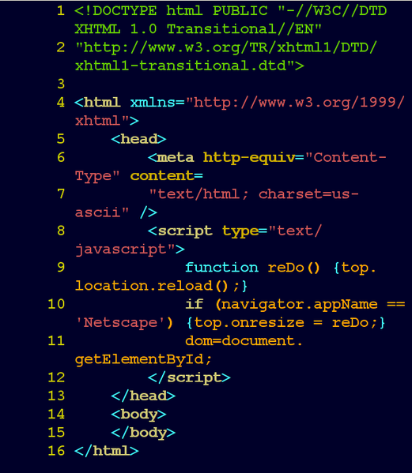


Crawling the DATA
Cheerio.js
SQLite

Slide 5
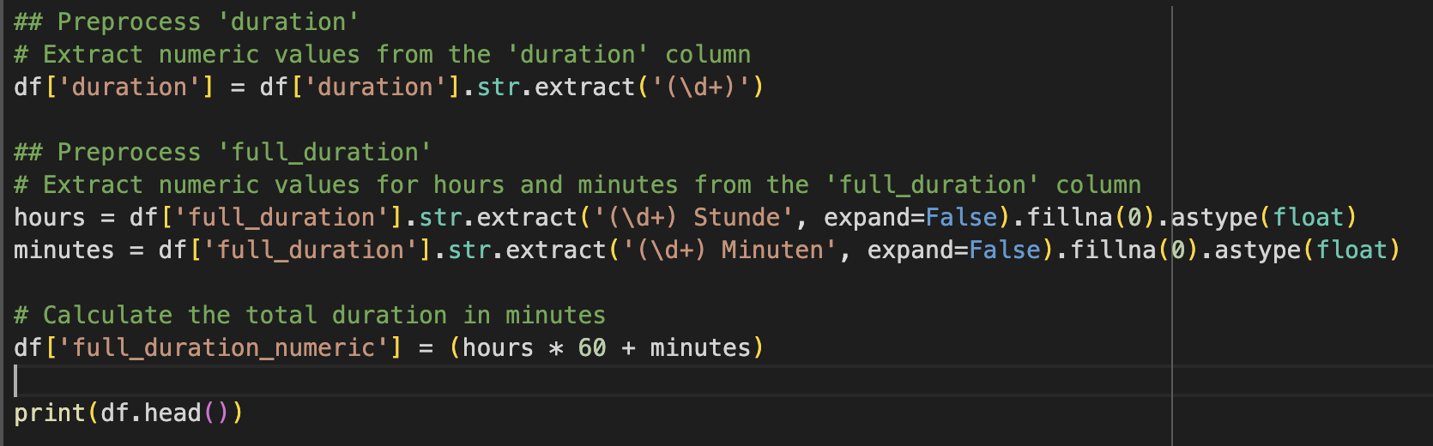
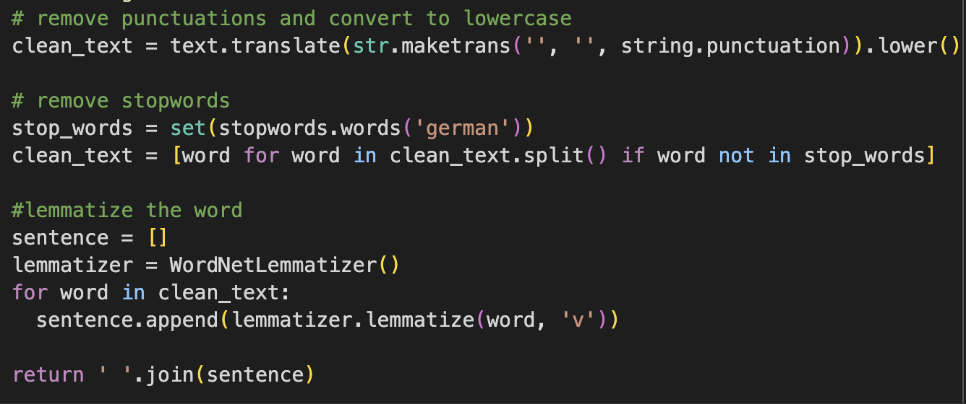
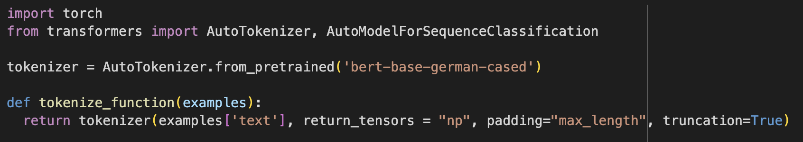
Preprocessing

Slide 6
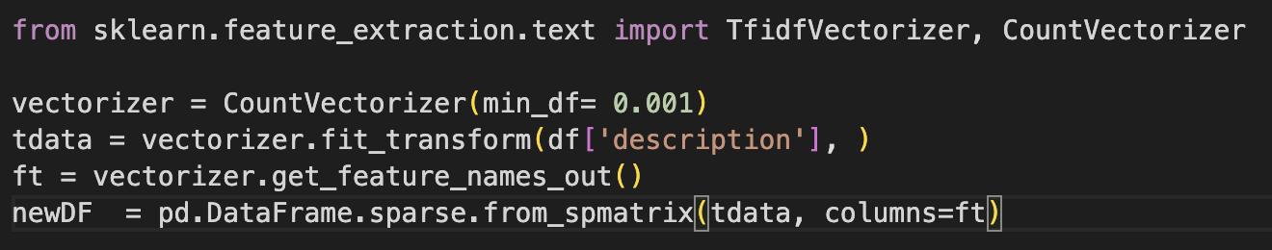
Preprocessing

Slide 7
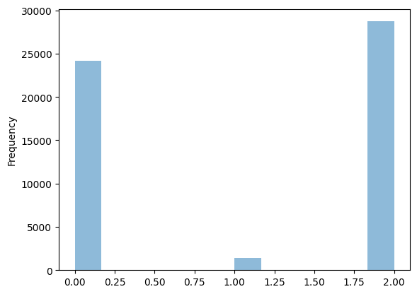
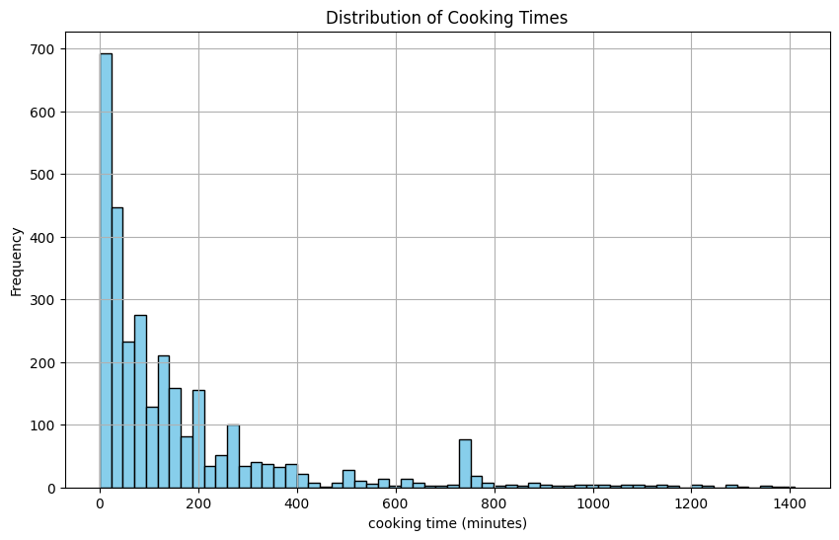
Preprocessing

Slide 8
TRANSFORMER ARCHITECTURE
BERT Model (Bidirectional Encoder Representations from Transformers)
Pre-trained on a large corpus of text data
Easy to fine tune using just one additional output layer
We used a BERT instance pre-trained on German texts by the Bavarian State Library

Slide 9
Data Preprocessing
TEXT TOKENIZATION:
BERT Tokenizer `bert-base-german-cased`
Padding to the maximum length (512 tokens)
Truncation enabled
LABEL PREPROCESSING:
Mapped difficulties to integers (0, 1, 2)
Converted full_duration to floats
Tried normalizing the full_duration

Slide 10
CLASSIFICATION TASK
Fine-tuned the `BertModelForSequenceClassification`
3 output classes
Optimizer: AdamW with weight-decay
Learning-rate scheduling
Best accuracy on the test-dataset: 0.696

Slide 11
Regression TASK
Fine-tune pre-trained BERT model
Add a linear layer instead of a dense pooling layer after transformers
MSE loss function
AdamW optimizer
Result so far:
R2-Score: -0.132
Regression fits worse than a horizontal line
Next step: try neural network for regression

Slide 12
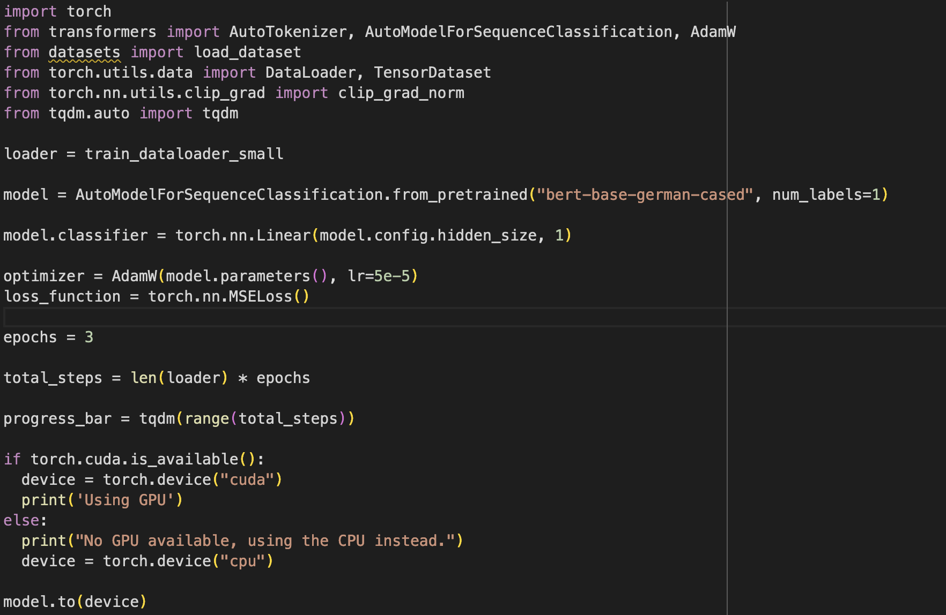
REGRESSION TASK

Slide 13
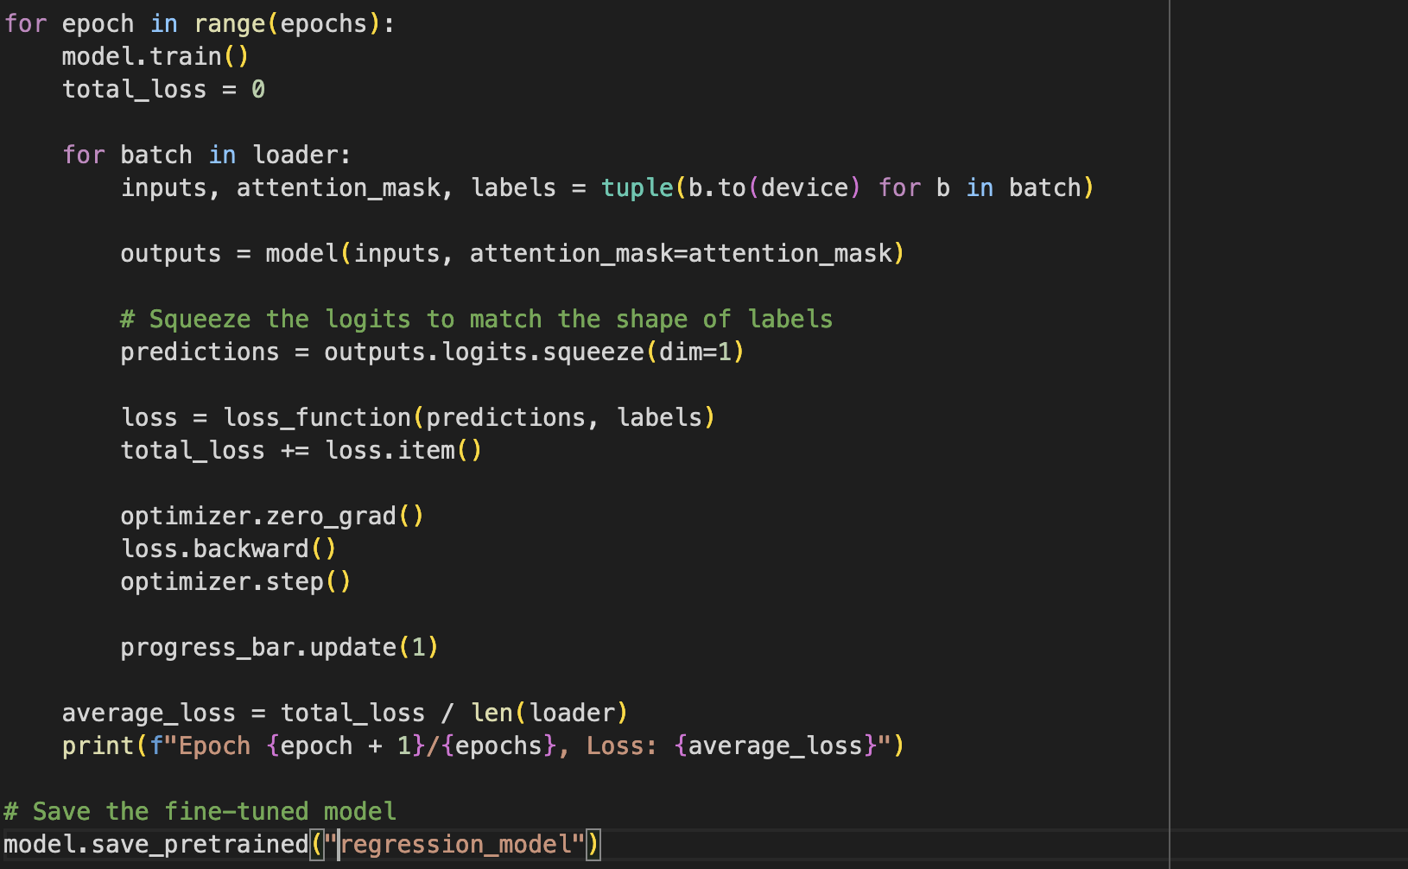
REGRESSION TASK

